Slide 1
Digital Portfolio
STUDENT NAME: Shiyamala.V
REGISTER NO AND NMID: 222402546|asunm161222402546
DEPARTMENT: Computer Science
COLLEGE: Prince Shri Venkateswara Arts and Science College /Madras University

Slide 2
PROJECT TITLE
DIGITAL PORTFOLIO USING FRONTEND WEB DEVELOPMENT

Slide 3


AGENDA
Problem Statement
Project Overview
End Users
Tools and Technologies
Portfolio design and Layout
Features and Functionality
Results and Screenshots
Conclusion
Github Link
3/21/2024 Annual Review

Slide 4

PROBLEM STATEMENT
In today’s competitive job market, professionals often struggle to showcase their skills and achievements in a way that is both comprehensive and engaging for potential employers or clients. Traditional paper-based resumes and portfolios fail to capture the breadth of a person’s capabilities, especially in fields that require visual or interactive proof of competence. There is a need for a platform or solution that allows individuals to create, manage, and share a dynamic digital portfolio that can evolve with their career, highlight their work, and demonstrate their skills in an engaging, interactive, and easily shareable format.

Slide 5

PROJECT OVERVIEW
The project aims to develop a comprehensive and user-friendly digital portfolio platform that allows professionals (designers, developers, writers, photographers, educators, etc.) to create and manage their portfolios online. The platform will provide users with customizable templates, multimedia support, interactive features, and seamless sharing options to showcase their skills, work, and achievements effectively.

Slide 6

WHO ARE THE END USERS?
1. Creative Professionals 2. Tech Professionals 3. Writers & Content Creators
4. Educators & Academics
5. Entrepreneurs & Freelancers 6. Students & Job Seekers

Slide 7

TOOLS AND TECHNIQUES
> Front-End Development
> Back-End Development > Database > File Storage > Version Control & Collaboration > Content Management Systems (CMS) > Analytics and Insights

Slide 8
POTFOLIO DESIGN AND LAYOUT
1.Cover Page
Name / Logo,Tagline (optional)cContact Information (optional)
2.About Me / Introduction
Brief Bio,Professional Statement,Skills Overview
3.Portfolio Highlights
Featured Projects,Project Descriptions,Tools & Technologies Used
4.Work Experience
Job Title(s),Company/Organization Name(s),
Responsibilities & Achievements
8

Slide 9
FEATURES AND FUNCTIONALITY
°About
°SectionHome/
Landing
°PageProjects /
Work Showcase
°Resume / CV
°Contact Page
°Search & Filter
°Interactive Design
°Responsive Design
°Embedded Media

Slide 10
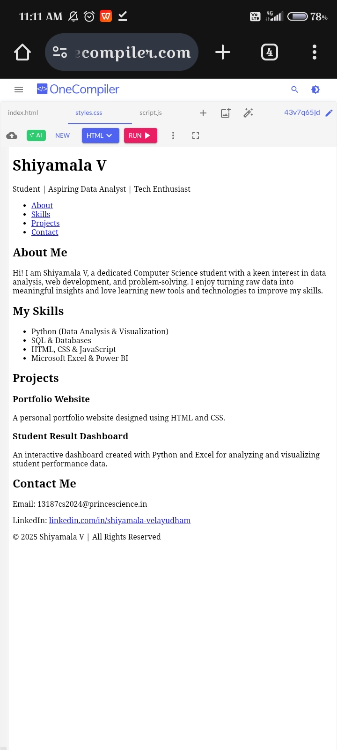

RESULTS AND SCREENSHOTS
/* General Styling */
body {
font-family: monospace, monospace;
margin: 0;
line-height: 1.6;
background: #000; /* Full black background */
color: #fff; /* White text for readability */
}
/* Header */
header {
background: #000; /* Match background with body */
color: #fff;
padding: 30px 0;
text-align: center;
}
/* Navigation */
nav {
background: #000;
}
nav ul {
display: flex;
justify-content: center;
padding: 0;
list-style: none;
margin: 0;
}
nav ul li {
margin: 0 15px;
}
nav ul li a {
color: #ffcc00; /* Highlighted links */
text-decoration: none;
font-weight: bold;
}
nav ul li a:hover {
text-decoration: underline;
color: #fff;
}
/* Section */
.container {
width: 80%;
margin: auto;
padding: 20px 0;
}
h2 {
margin-bottom: 15px;
color: #ffcc00; /* Yellow headings */
}
/* Skills */
.skills-list {
list-style: none;
padding: 0;
}
.skills-list li {
display: inline-block;
background: #111;
padding: 10px 15px;
margin: 5px;
border-radius: 5px;
color: #ffcc00;
}
/* Projects */
.project-card {
background: #111;
padding: 15px;
margin: 10px 0;
border-left: 5px solid #ffcc00;
box-shadow: 0 2px 4px rgba(255,255,255,0.1);
}
/* Footer */
footer {
background: #000;
color: #fff;
text-align: center;
padding: 15px;
}
3/21/2024 Annual Review
10

Slide 11
CONCLUSION
A digital portfolio is not just a collection of work samples, but a reflection of one’s skills, creativity, and professional identity. It serves as a powerful platform to showcase achievements, projects, and experiences in a visually engaging and easily accessible manner. With the right design, features, and functionalities, a digital portfolio enhances credibility, improves visibility, and creates lasting impressions on recruiters, educators, or clients. In today’s digital world, having a well-structured portfolio is essential for personal branding, career growth, and demonstrating expertise effectively.
11

